Slide 1

Design of a Home Multi-Robot System for the Elderly and Disabled
Patrick Benavidez

Slide 2
Overview
Introduction
Proposed Home Robotic System
Software and Simulation Environment
Hardware
Summary of Contributions and Completed Work
Future Work

Slide 3
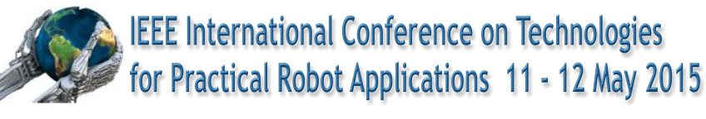


Introduction
Demand is only increasing for assistive robots
Japan, Europe, Korea and the US all have age-related population problems that can be helped by assistive robots
The Robotics and Automation Society states that important research projects have been recently launched in Europe, Japan and Korea. The US is not even listed as a key player in the research. [http://www.ieee-ras.org/rehabilitation-robotics]
Conferences: IEEE International Conference on Rehabilitation Robotics (ICORR) –2013 attendance: 340, IEEE Technologies for Practical Robot Applications (TePRA), The Rehabilitation Engineering and Assistive Technology Society of North America (RESNA) partners with ICORR
Regular IEEE Spectrum e-articles asking “where are our home robots?”

Slide 4
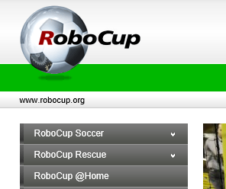
Introduction
Demand is increasing for assistive robots (cont.)
RoboCup added an @Home event described as “largest international annual competition for autonomous service robots and is part of the RoboCup initiative” [http://www.robocup.org/robocup-home/]

Slide 5
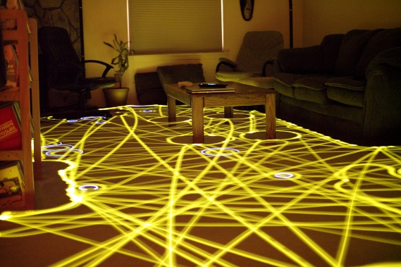
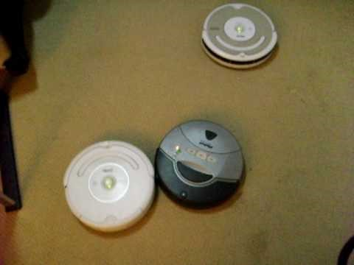
Introduction (cont.)
Multiple robots and effect on task space
Existing robot systems work in their own environment
Roomba works as if it is the only robot in a room
Task spaces are assumed to be the entire area
Simple sensor beacons are used to control robots
Task space could be split up into parts
Make execution of task more efficient
Robots can build sophisticated maps of the environment for navigation – could be used to partition
http://en.wikipedia.org/wiki/File:Roomba_time-lapse.jpg
https://www.youtube.com/watch?v=S7plVfRA2jQ#t=48

Slide 6
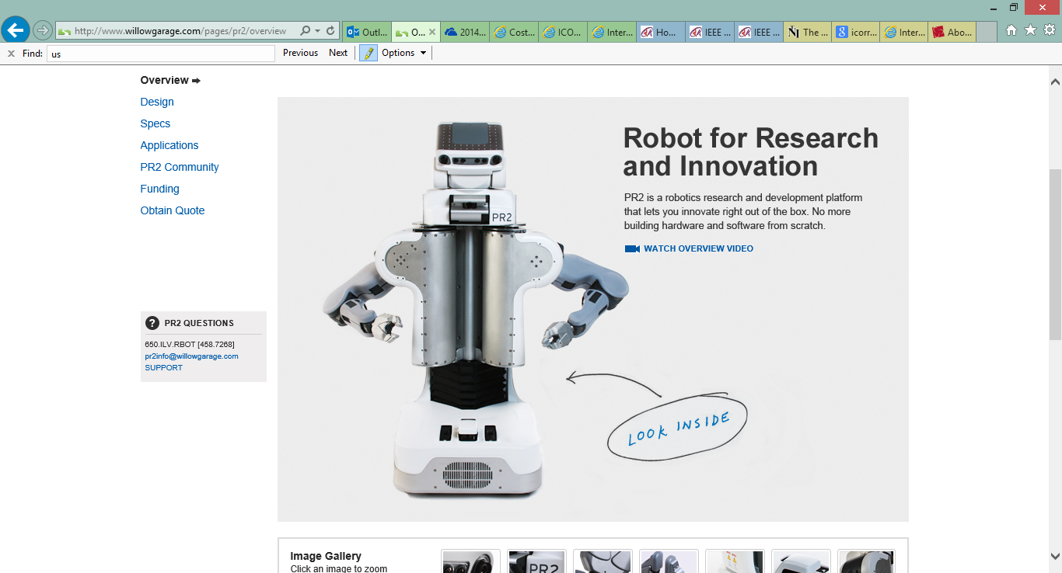
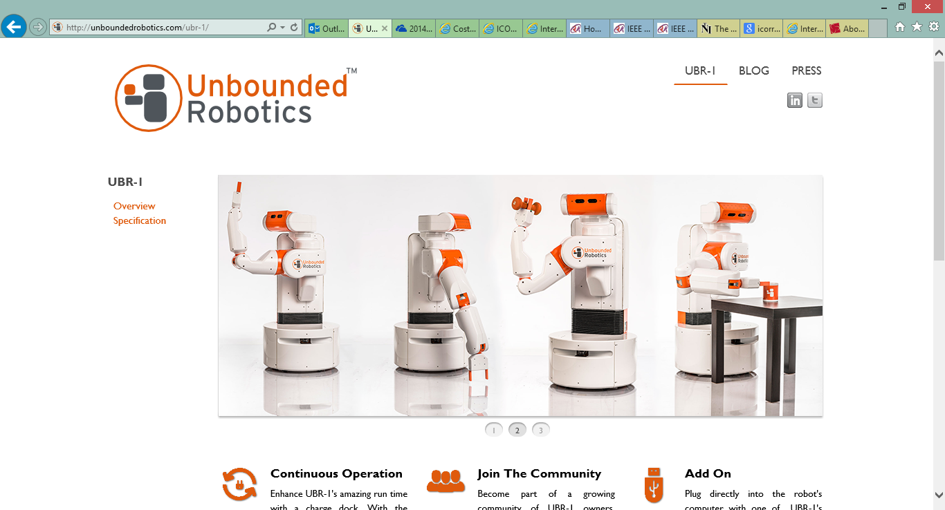
Introduction (cont.)
Networked and Cloud Robotics
WillowGarage decided to make things easier for researchers with ROS and PR-2 showpiece
Unbounded Robotics was formed by former WillowGarage employees have their UBR-1 ~$35k
Cost: ~$330k
Criticized by AARP for being too slow at folding towels and very expensive
http://unboundedrobotics.com/ubr-1/
http://www.willowgarage.com/pages/pr2/overview

Slide 7
Introduction (cont.)
Networked and Cloud Robotics
WillowGarage decided to make things easier for researchers with ROS and PR-2 showpiece
Unbounded Robotics was formed by former WillowGarage employees have their UBR-1 ~$35k
Unfortunately for Unbounded Robotics, the UBR-1 was bound to fail due to derivative work clauses in the former employee’s contracts
Cost: ~$330k
Criticized by AARP for being too slow at folding towels and very expensive
Unbounded Robotics was forced to close
http://unboundedrobotics.com/ubr-1/
http://www.willowgarage.com/pages/pr2/overview

Slide 8
Proposed Home Robot System

Slide 9
Proposed Home Robot System
The proposed system is designed with the following top level goals:
Provide an application set to suit the general needs of user population
Develop the system to be extensible and configurable
Partition task space for heterogeneous robots

Slide 10
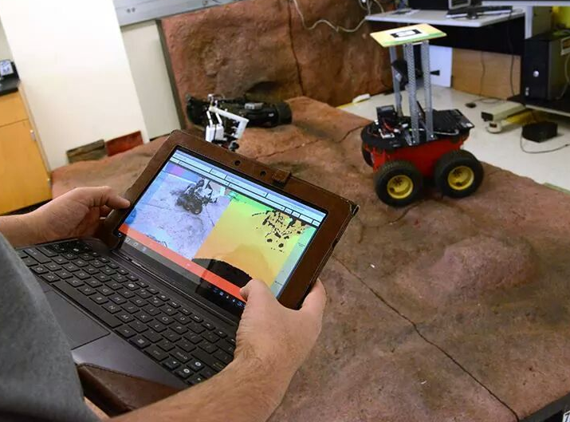
Proposed Home Robot System System Extensibility & Configurability
The following principles are proposed to extend the usefulness of the system:
Use of cloud computing technology to provide data processing support and to allow expansion of services
Provide a set of standards allowing cooperative robot control in system
Openness to allow application (app) driven control of robots in system
Integration with existing equipment such as security systems and cameras, or “smart” IoT devices
Photographer: Deborah Silliman Wolfe

Slide 11
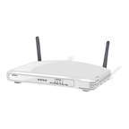
Proposed Home Robot System System Extensibility & Configurability (Cont.)
How to manage all this in the home?
Integration with existing equipment
Cloud Back End

Slide 12
Proposed Home Robot System System Extensibility & Configurability (Cont.)
How to manage all this in the home?
Integration with existing equipment
standards allowing cooperative robot control
Cloud Back End

Slide 13
Proposed Home Robot System System Extensibility & Configurability (Cont.)
How to manage all this in the home?
Integration with existing equipment
standards allowing cooperative robot control
allow application (app) driven control of robots
Cloud Back End

Slide 14
Proposed Home Robot System System Extensibility & Configurability (Cont.)
How to manage all this in the home?
Integration with existing equipment
standards allowing cooperative robot control
allow application (app) driven control of robots
use of cloud computing technology
Cloud Back End

Slide 15
Proposed Home Robot System System Extensibility & Configurability (Cont.)
What happens when another robot is here? Will it help me?
How to manage all this in the home?
Integration with existing equipment
standards allowing cooperative robot control
allow application (app) driven control of robots
use of cloud computing technology
Cloud Back End

Slide 16
Proposed Home Robot System System Extensibility & Configurability (Cont.)
How to manage all this in the home?
Use of open-source Robot Operating System (ROS) middleware
Provides a common API for process-to-process and machine-to-machine communication
Provides instructions and some API to access system via non-ROS applications such as “apps” on a mobile device
Drivers can be made for existing or legacy equipment
Integration with existing equipment
standards allowing cooperative robot control
allow application (app) driven control of robots
use of cloud computing technology
Cloud Back End

Slide 17

Proposed Home Robot System System Extensibility & Configurability (Cont.)
How to manage all this in the home?
Offload a portion of the work to the Internet Connected Home Portal (ICHP) and to the cloud
Device can be similar in form to a wireless router or cable internet modem
Maintains high bandwidth connections to robots
Provides intermediary link between N robots and cloud computing
Integrates with existing “smart” components
ICHP

Slide 18
Proposed Home Robot System System Extensibility & Configurability (Cont.)
How to manage all this in the home?
Offload a portion of the work to the Internet Connected Home Portal (ICHP) and to the cloud
Device can be similar in form to a wireless router or cable internet modem
Maintains high bandwidth connections to robots
Provides intermediary link between N robots and cloud computing
Integrates with existing “smart” components
use of cloud computing technology
Cloud Back End
ICHP
Internet Link to Cloud

Slide 19
Proposed Home Robot System System Extensibility & Configurability (Cont.)
How to manage all this in the home?
Offload a portion of the work to the Internet Connected Home Portal (ICHP) and to the cloud
Device can be similar in form to a wireless router or cable internet modem
Maintains high bandwidth connections to robots
Provides intermediary link between N robots and cloud computing
Integrates with existing “smart” components
use of cloud computing technology
Cloud Back End
ICHP
Internet Link to Cloud
Integration with existing equipment
allow application (app) driven control of robots

Slide 20
Proposed Home Robot System System Extensibility & Configurability (Cont.)
How to manage all this in the home?
Offload a portion of the work to the Internet Connected Home Portal (ICHP) and to the cloud
Device can be similar in form to a wireless router or cable internet modem
Maintains high bandwidth connections to robots
Provides intermediary link between N robots and cloud computing
Integrates with existing “smart” components
use of cloud computing technology
Cloud Back End
ICHP
Internet Link to Cloud
Integration with existing equipment
allow application (app) driven control of robots

Slide 21
Proposed Home Robot System System Extensibility & Configurability (Cont.)
standards allowing cooperative robot control
Seems fair, the workload is divided
How to manage all this in the home?
Offload a portion of the work to the Internet Connected Home Portal (ICHP) and to the cloud
Device can be similar in form to a wireless router or cable internet modem
Maintains high bandwidth connections to robots
Provides intermediary link between N robots and cloud computing
Integrates with existing “smart” components
standards allowing cooperative robot control
use of cloud computing technology
Cloud Back End
ICHP
Internet Link to Cloud
Integration with existing equipment
allow application (app) driven control of robots

Slide 22
Proposed Home Robot System Set of Applications to Suit General Needs of User Population
A proof of concept set of applications are proposed to provide assistance in the following areas:
Vision & Social
Mobility
Physical
Cleaning and Safety
We propose that these tasks be split between two type of robots:
Movement and Vision Assistance Robot (MVAR)
Floor Cleaning Robot(FCR)

Slide 23
Proposed Home Robot System Floor Cleaning Robot (FCR)
(1)
(2)
(3)
(4)
Components
Manipulator arm (1)
RGB-D input device (2)
Vacuum or other cleaning device (3)
Object retrieval scoop and bay (4)
FCR

Slide 24
Proposed Home Robot System Floor Cleaning Robot (FCR)
Floor Cleaning Tasks | Driving Technology
Dirty area identification for vacuuming/sweeping/mopping | RGB-D based dirty area identification
Small object pickup | Floor RGB-D model comparison and/or database lookup
 | Mapping of house walkways
 | Manipulator mechanism and control
Self-emptying of dirt bin | Manipulator and dirt bin mechanical compatibility
 | Identification of trash can area by RGB-D
Liquid spill identification and cleanup | Spill identification
 | Mopping bar tool
 | Navigation to spill location

Slide 25
Proposed Home Robot System Movement and Vision Assistance Robot (MVAR)
Components
Wheeled walker frame
Tablet screen UI
RGB-D camera (i.e. Kinect)
Manipulator arm
Motors
Batteries
Electronics
MVAR

Slide 26
Proposed Home Robot System Movement & Vision Assistance Robot (MVAR)
Movement Assistance Tasks | Driving Technology
Assist in bearing weight of user | Assistive braking
 | Pressure Sensors
Passive path suggestions if obstacles block current path | Obstacle detection via RGB-D sensor and learned floor model
 | Grade detection via RGB-D and accelerometer sensors
Active path control to avoid critical obstacles and paths | Same as passive system above
 | Velocity control of platform
“Come-to-me” feature | Mapping of house walkways
 | Beacon and sensor array
 | Teleoperation
Exercise and/or rehabilitation | Pre-programmed exercises
 | Waypoint following

Slide 27
Proposed Home Robot System Movement & Vision Assistance Robot (MVAR)
Vision Assistance Tasks | Driving Technology
Reading visual text input | Navigation/manipulation to obtain picture of text input
 | Optical character recognition (OCR) on visual input
 | Synthesize read text to speech
Reading emails out loud | Save email text to appropriate format for voice synthesis
 | Voice synthesis of digitally formatted words
Accept voice commands | Voice recognition software to decode verbal commands
 | Turn decoded commands into actions
 | Verbal Response
Zoom-in on visual input for display on large tablet screen | Optical zoom
 | Digital zoom

Slide 28
Proposed Home Robot System Cooperative Controller
Cooperation is a necessity for household robots operating in overlapping environments with human operators involved
Current household robots like the Roomba move until they hit obstacles.
Small scale homogeneous (swarm-style) robots colliding with one another is usually assumed to be acceptable (Roomba Fight Video)
But this is NOT sufficient considering that safety of the user IS THE TOP CONCERN

Slide 29
Proposed Home Robot System Cooperative Controller
Example situations will be encountered where MVAR and FCR should work together:
MVAR crosses paths with FCR in a projected trajectory (pictured)
FCR finds a dirty area under MVAR frame
Transporting items picked up by FCR to MVAR to user/operator

Slide 30
Proposed Home Robot System Cooperative Controller
Policies need to be established for situations where cooperation is either beneficial in terms of:
safety (to prevent operator injury)
cost reduction (to use smaller cheaper components, i.e. smaller robotic arms) and sharing across both platforms

Slide 31
Proposed Home Robot System Cooperative Controller
Cooperative Controller Tasks | Driving Technology
Robot-to-Robot coordination of navigation actions | Swarm-based simulation of intended paths for collision detection and flagging
 | Task priority driven decision making
 | Communication of actions via wireless radio
Human-to-Robot coordination of robot-to-human navigation actions | Human detection and tracking
 | Verbal/visual/non-verbal communication of action to human
 | Safety driven decision making
Human-to-Robot coordination of coupled Robot-to-Robot actions | Communication to begin action
 | Navigation to close proximity
 | Identification of manipulation action

Slide 32
Software and Simulation Environment

Slide 33
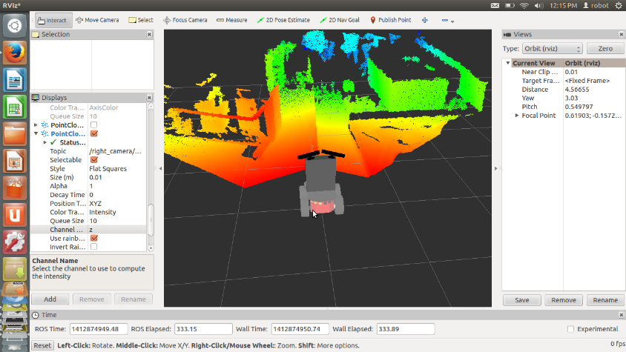
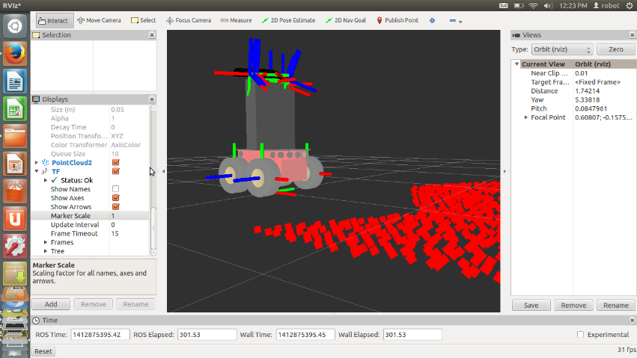
Software and Simulation Environment
Software | Name and Version
Operating System | Ubuntu Linux 12.04 LTS
Robot Middleware | Robot Operating System (ROS) (Hydro Release)
Image Processing | OpenCV 2.4.6 (ROS Hydro Release Version)
3D Point Cloud Processing | PCL 1.7.0 (ROS Hydro Release Version)
3D Simulator | ROS Gazebo Simulator 1.5?

Slide 34
Hardware

Slide 35
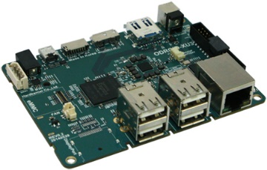
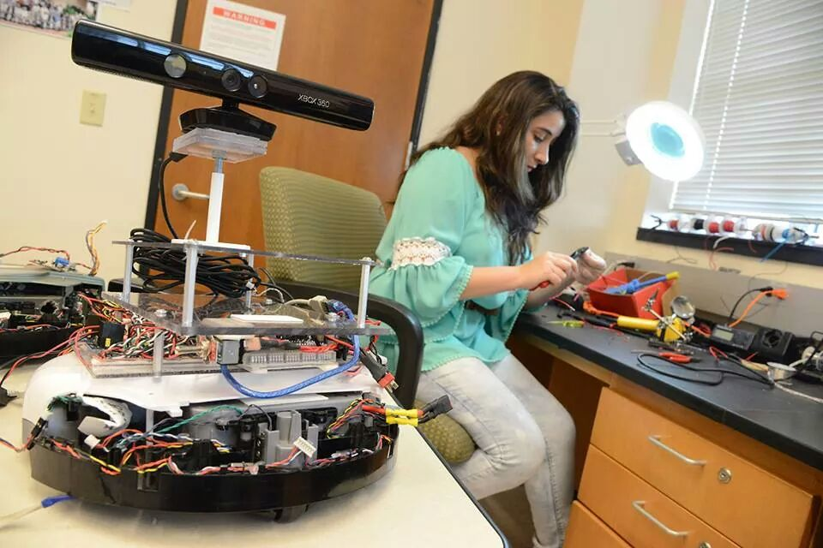
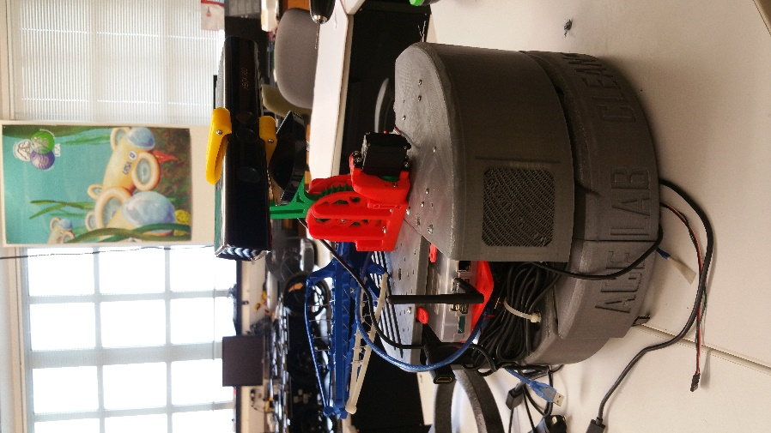
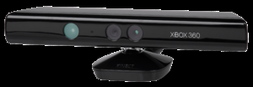
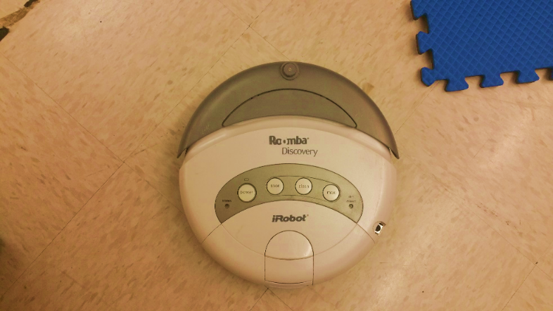
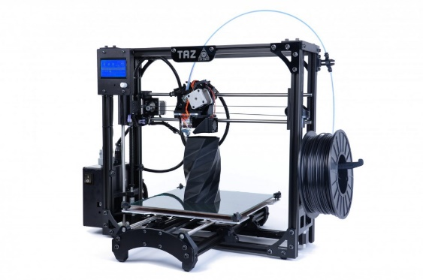
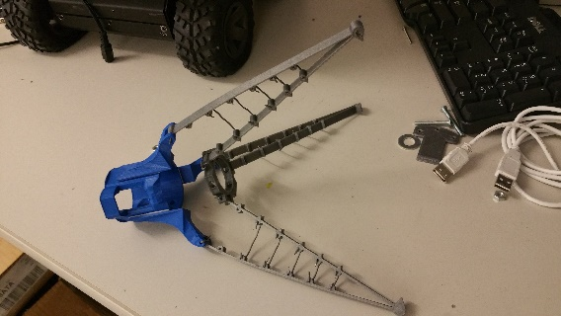
Hardware – FCR
More rigid 3D printed prototype
http://dn.odroid.com/homebackup/XU3LiteMain.jpg
http://en.wikipedia.org/wiki/Kinect
Very early prototype
Roomba Discovery (circa 2004)

Slide 36
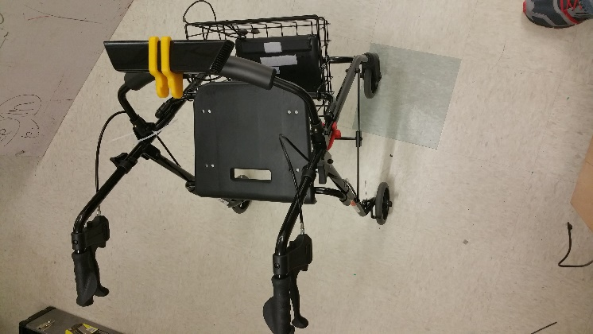
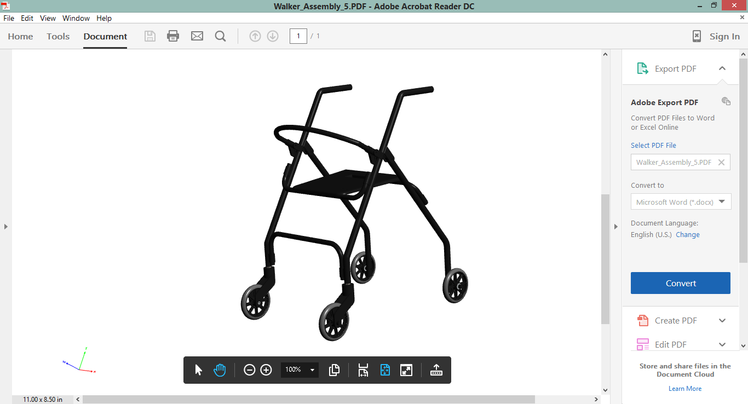
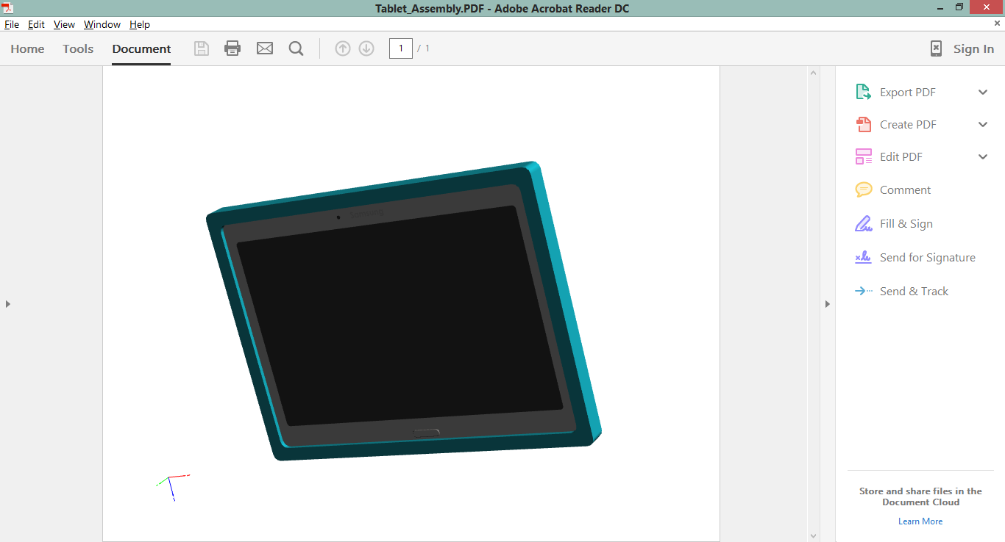
Hardware – MVAR
Design to be completed soon
http://dn.odroid.com/homebackup/XU3LiteMain.jpg
http://en.wikipedia.org/wiki/Kinect
Nova GetGo Walker
SolidWorks model by UTSA’s Eric Wineman

Slide 37
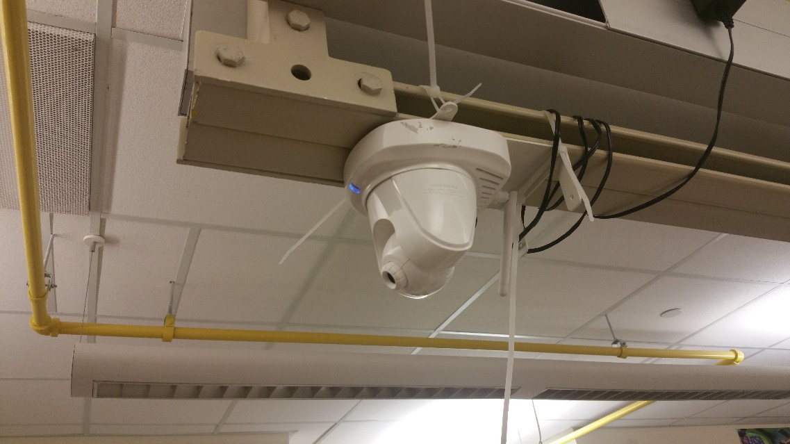
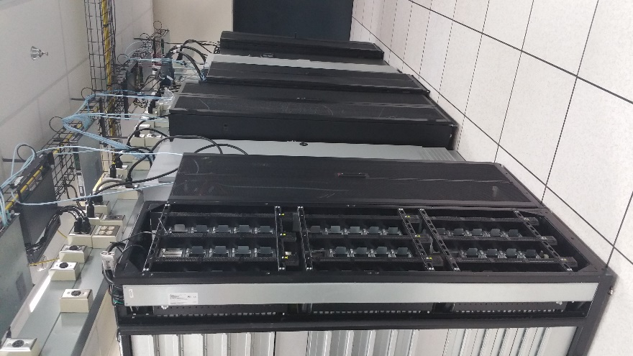
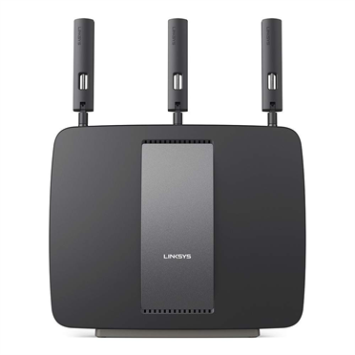
Hardware - Infrastructure
UTSA Cloud-
Research Data Center
(RDC)
Trendnet Wireless IP Camera
http://www.linksys.com/images/productmt/834023/372.jpg

Slide 38
Summary of Contributions and Completed Work

Slide 39

Completed Work
Modifications to drive a salvaged iRobot Roomba in ROS
Wired motor drivers and Arduino microcontroller to computer
Added lithium polymer battery for extended use
Added Kinect and related hardware
Added an embedded ODROID Xu3 computer with 8 cores in big.LITTLE configuration
3D Printed and assembled under-actuated gripper
3D Printed many components of robot base ~200 printing hours

Slide 40
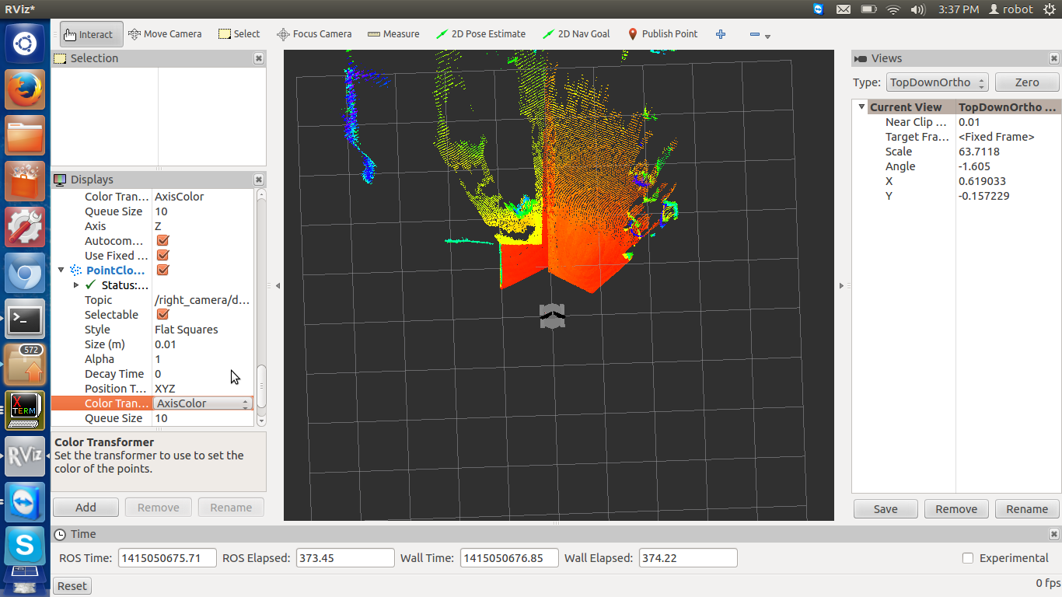
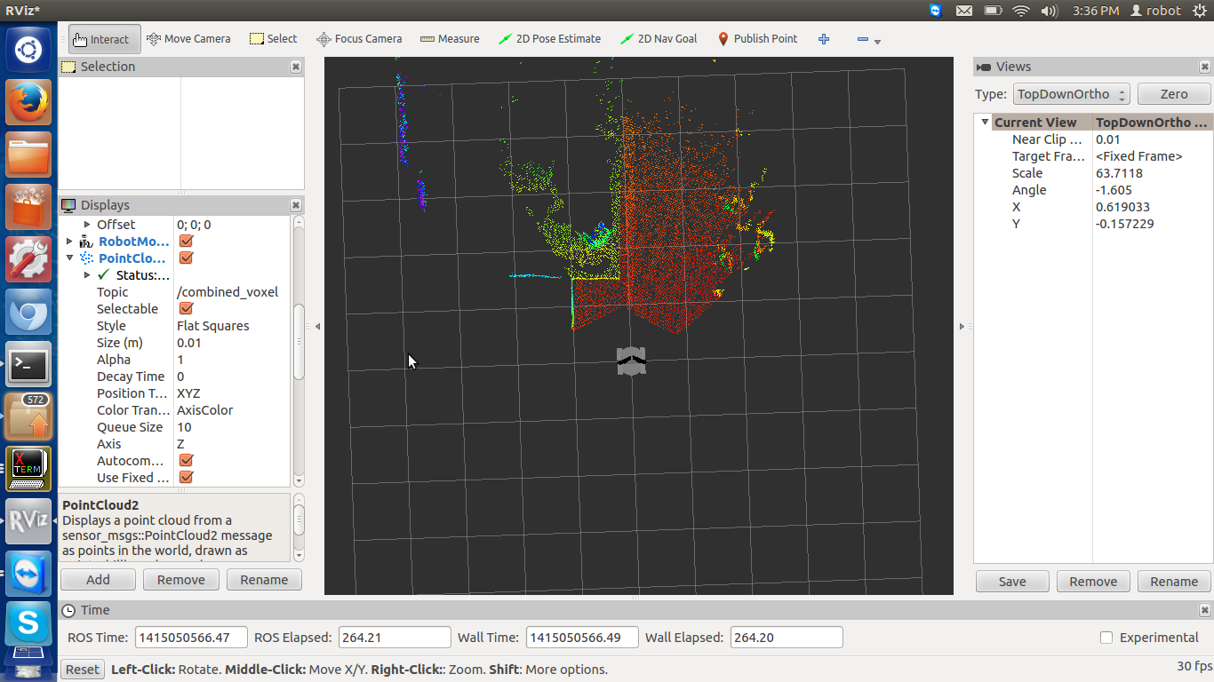
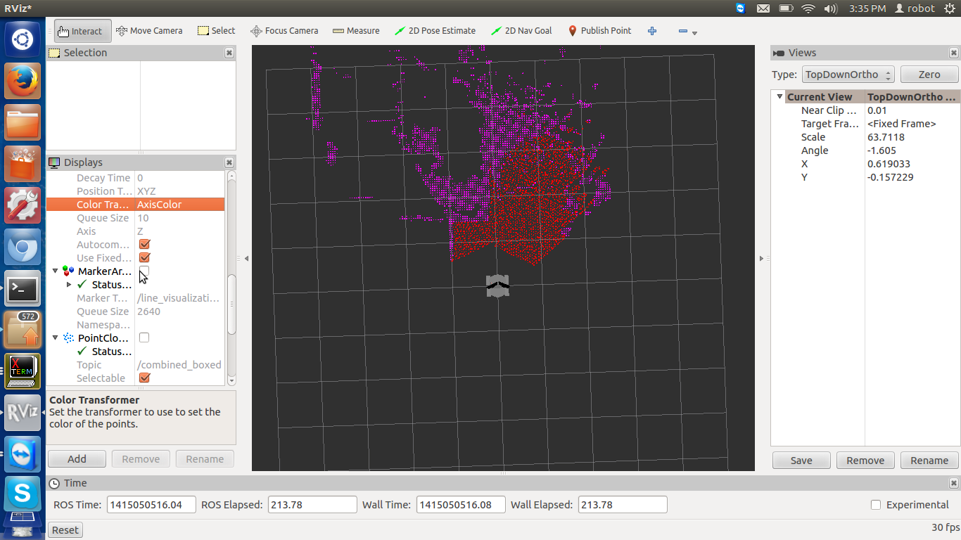
Completed Work
3D point cloud data processing
Now very experienced in PCL software
Methods to filter, geometrically transform to fix orientation, and process data
RGB+D image processing
Calibrated cameras of the Kinect
Software developed to acquire and process both RGB & D images in ROS for processing

Slide 41

Completed Work
Commercial cleaning motions & control examples

Slide 42
Completed Work
ROS on the Cloud
Feature matching for Visual SLAM via ROS-based mechanism similar to MPI
Implemented the network setup for successful experimentation

Slide 43
Future Work

Slide 44
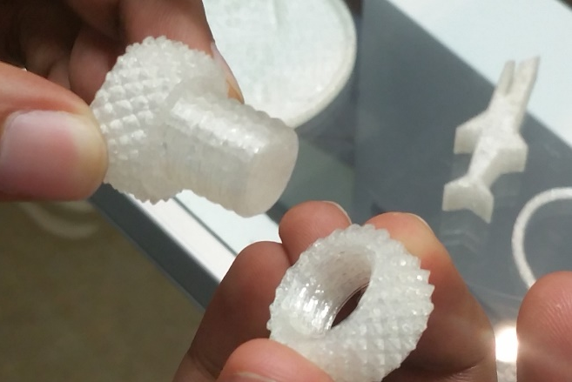
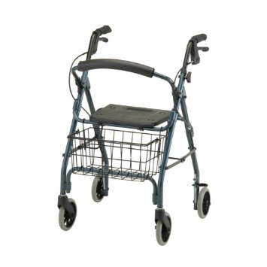
Future Work
FCR
Add manipulator arm*
Simulation on FCR Small Item Detection
Experiment on FCR Cleanup of Small Liquid Spill
MVAR
Add manipulator arm*
Simulation on Home State Recognition
Experiment on Passive and Active Navigation
Cooperative Controller
Simulation on Robots Crossing Paths
Experiment on Small Object Handoff
ICHP
*Custom designs using 3D printed parts from ACE Lab’s soon-to-be acquired 3D printer

Slide 45
Simulations
Home State Recognition
Goals:
1) Detect states of light switches in a room.
2) Detect state of deadbolt locks.
Limitation: Use of datasets taken in apartment and in ACE Lab of light switches
Time permitting: the simulation will become an experiment with live detection of the switch state

Slide 46
Experiments
MVAR Passive and Active Navigation
Goal: Navigate through an environment typical to that of a household.
Limitation: dataset only from apartment, experiment in ACE Lab
MVAR with User
Good Path for MVAR
Obstacles
Water Spill
Hard Floor
Destination

Slide 47
Questions?

Slide 48
Contributions
This work contributes following five items to the field of home robotics:
A new concept for a home multi-robot system for elderly care
Methods and system for a Floor Cleaning Robot (FCR)
Expansion of multi-robot system thinking to home robots with robot/human and robot/robot interactivity
Methods and system for a Movement and Vision Assistance Robot (MVAR)
A cooperative controller for enabling and organizing multi-robot interaction.

Slide 49
Proposed Home Robot System Floor Cleaning Robot (FCR)
External
Controller
Robot
Actions
External
Observer
Robot’s
Actions
Environment
Other Robot
Actuation
External Actors
Desired Actions & Reactions
Controllers
High Level Controllers
(Clean Area Avoidance, Small Object Manipulation, Cooperative Controller)
Onboard Sensors
(Distance,
Velocity, Position, Force)
Sensor Data
Low Level Controllers
(Obstacle Avoidance, Motion planning)
Robot
External Computer
Environmental

Slide 50
Proposed Home Robot System Movement & Vision Assistance Robot (MVAR)
External
Controller
Robot
Actions
External
Observer
Robot’s
Actions
Environment
Other Robot
Actuation
External Actors
Desired Actions & Reactions
Controllers
High Level Controllers
(Path Controller, Cooperative Manipulation Controller, Cooperative Path Controller)
Onboard Sensors
(Heading, Distance,
Velocity, Position, Force)
Sensor Data
Low Level Controllers
(Obstacle Avoidance, Motion planning, Braking)
Robot
External Computer
Environmental

